Slide 1
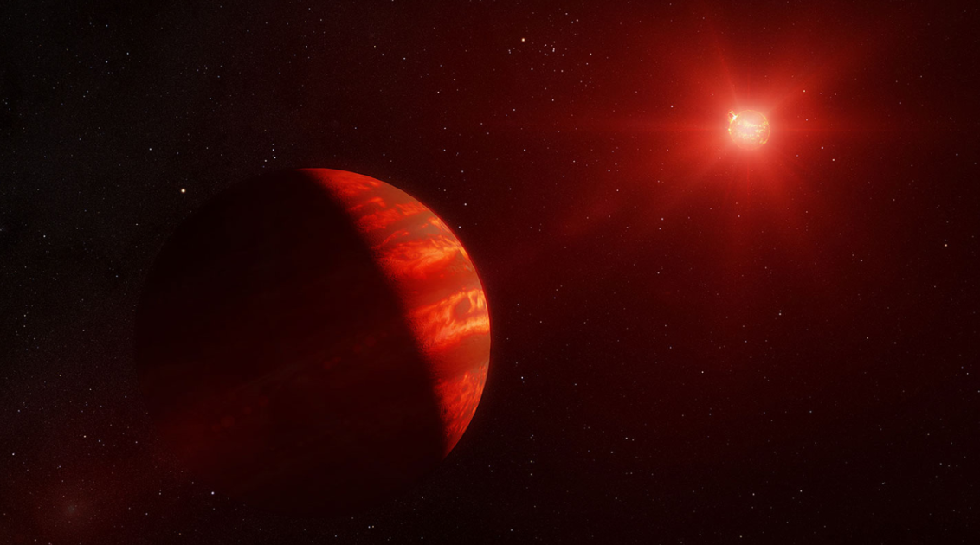


Analyzing the Near-Infrared Spectra of M & L Dwarfs
Jackson Headon, Kiera Charley, Jorge Sanchez, Peter Smith, Marah Brinjikji, Dr. Jennifer Patience

Slide 2
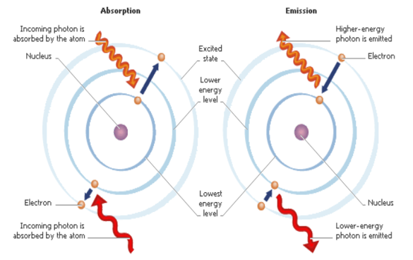
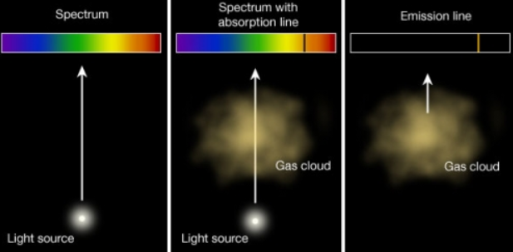
Background:
Light interacting with electrons raises the electron energy level within the atom
Different atoms require alternate amounts of energy to raise electron levels
Cooler atmospheres allow elements to exist in their neutral or less-ionized states

Slide 3
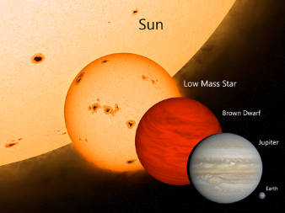
Motivation:
Most stellar observations take place in the visible light spectrum (400-800 nm)
M-stars exhibit some of the more prominent absorption line features
Give off optical and infrared wavelengths
L-dwarfs are significantly smaller and have cooler temperatures, making their absorption spectra much more difficult to detect in the optical

Slide 4
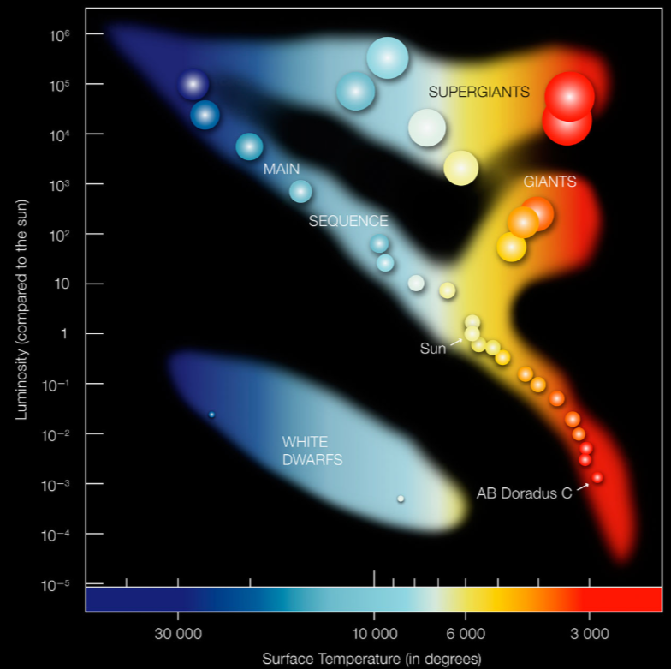
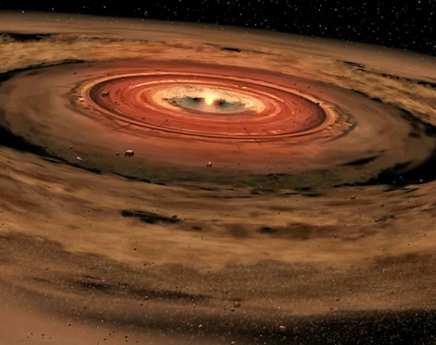
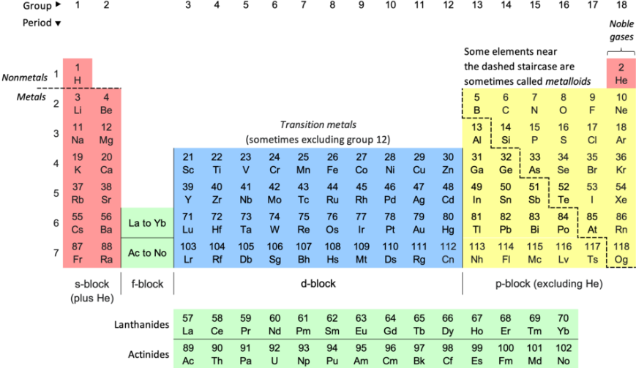
Goals:
Observe how absorption lines vary as a function of temperature between M and L-dwarfs
Determine what specific elements dominate the stars’ composition
Understand what their features tell us about their development

Slide 5
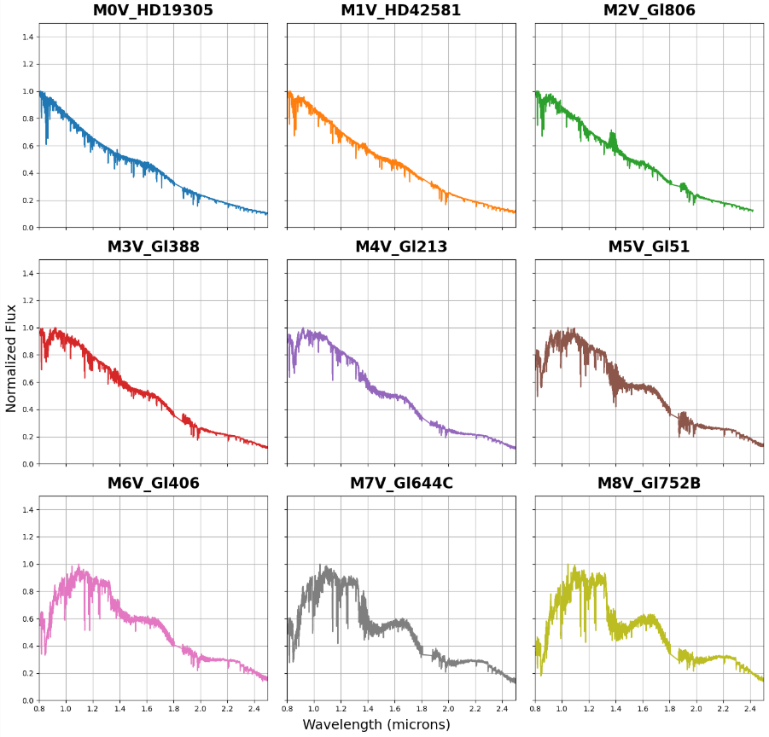
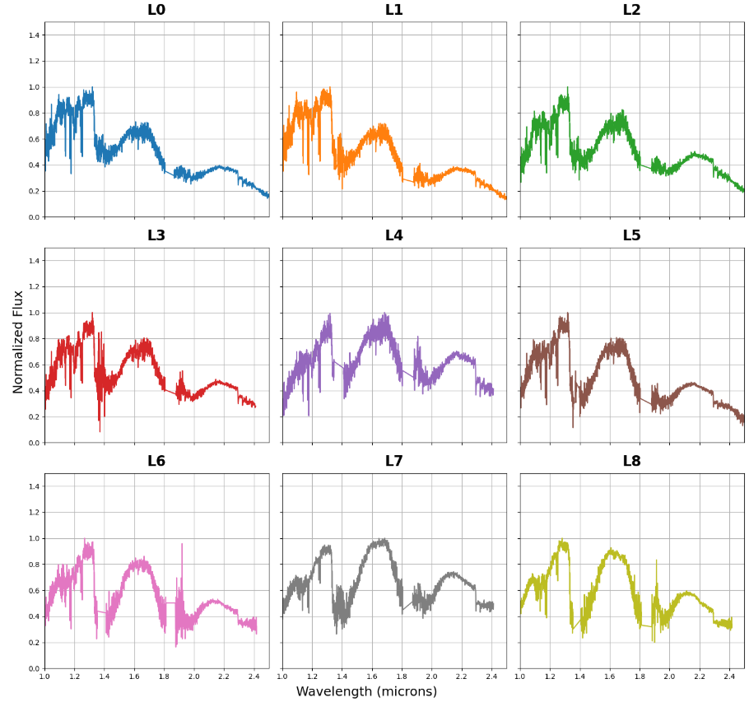
M-Dwarf Absorption Spectra
L-Dwarf Absorption Spectra

Slide 6
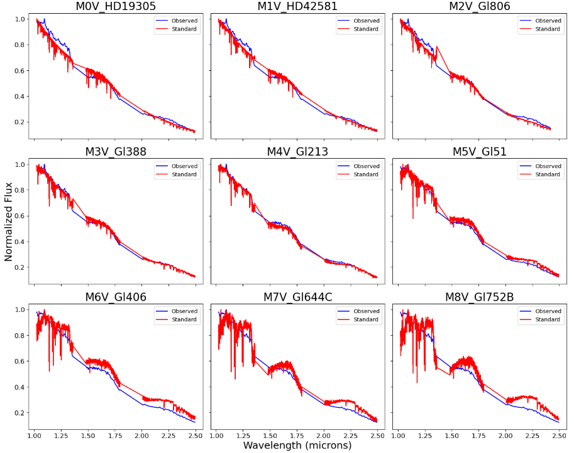
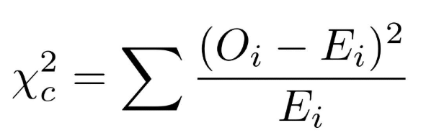
Applying Data:
Comparison of SpeX standard model (red) vs. observed stellar object (blue)
Chi-Squared goodness of fit

Slide 7
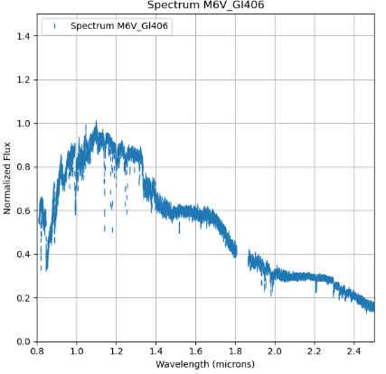
Why do we study this?:
Cooler stars allow for more prominent absorption features within near-infrared
Leads to greater variation of molecules present in the spectra at these wavelengths
Discover new absorption features as we shift between stellar boundaries!
Ex: Lithium bands present in L-dwarfs but not M-dwarfs
NaI
FeH
H20
H20
NaI

Slide 8
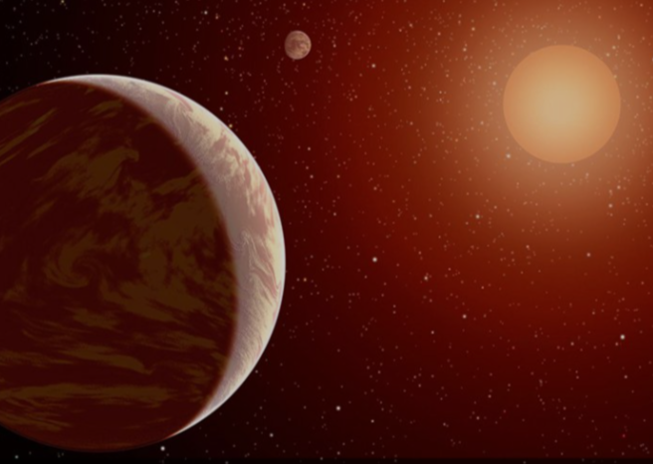
Future Steps:
Prominent absorption features within near-infrared bands dependent on the temperature of the star
Further analyze atmospheric composition and compare them to M and L-dwarf companions
Same system M and L-dwarfs will determine formation and migration patterns histories

Slide 9
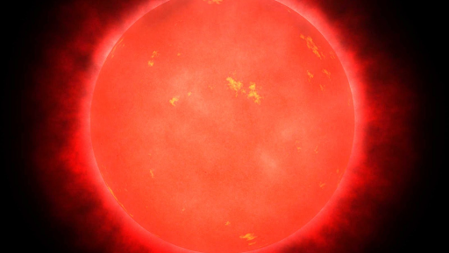
Thank you for listening!

Slide 10
References
B14: Bailer-Jones. C.A.L. (2014, ASlnC, 11,7)
C05: Cushing, M.C., Rayner, J.T, & Vacca, W.D. (2005, ApJ, 623, 1115) R09: Rayner, J.T., Cushing, M.C., & Vacca, W.D. (2009, ApJS, 185, 289)

